Slide 1
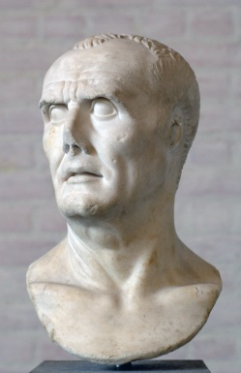
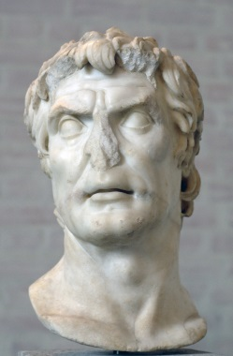
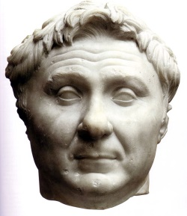
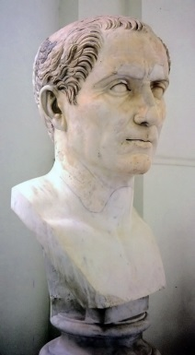
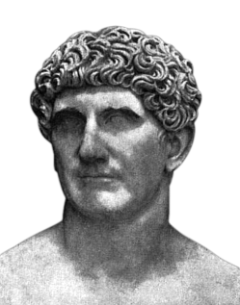
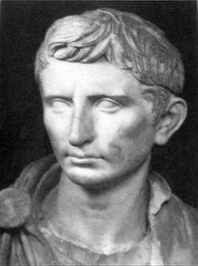
Civil Wars
Marius
Sulla
Pompey
Julius Caesar
Mark Antony
Octavian

Slide 2
Roman Political Factions
Optimates
Populares
Sing. optimatis
Supporters of senatorial power
Usually members of the patrician class
E.g. Sulla, Cato the Younger, Pompey (at the end)
Sing. popularis
Supporters of reforms favoring plebeian interests
Included many aristocrats and senators, as well as novi homines
E.g. the Gracchi, Marius, Julius Caesar

Slide 3
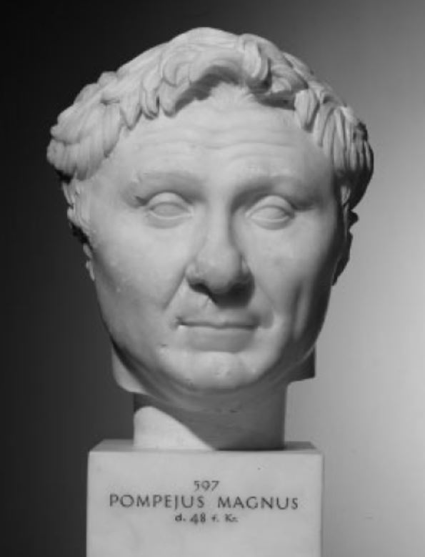
Pompey
Gnaeus Pompeius Magnus
c. 106-48 BCE
Served in the Social War under his father
When Sulla returned to Italy, Pompey raised three legions to support him
Crushed resistance to Sulla in Sicily and Africa, and demanded a triumph, even though he held no office

Slide 4
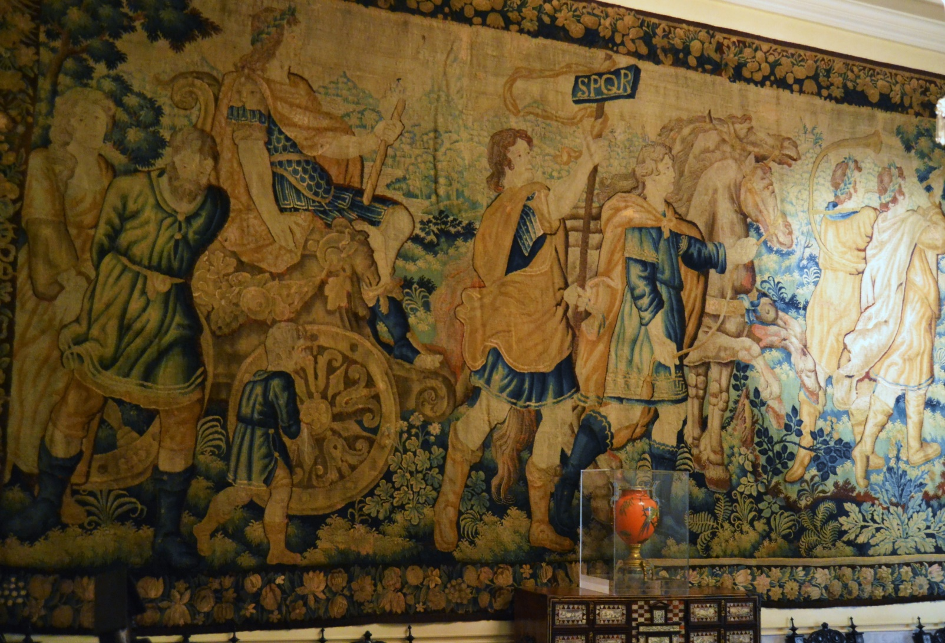
Roman Triumphs

Slide 5

Sulla
Appointed dictator in 82 BCE
Proscribed political opponents
Increased the Senate to 600 members
Limited the rights of tribunes
Replaced Equestrian judges with Senators
Resigned the dictatorship in 81, became consul in 80, retired in 79, died in 78

Slide 6
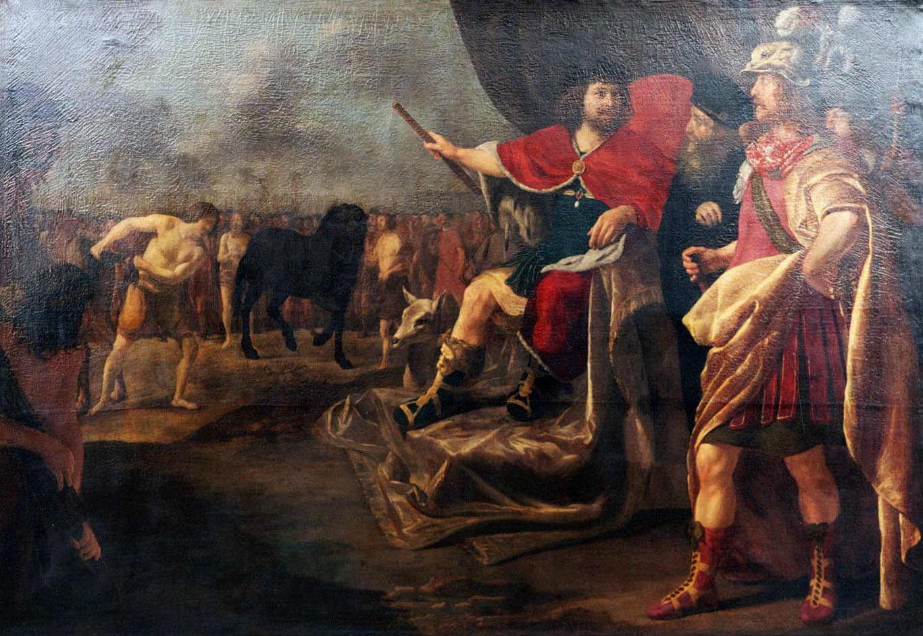
Sertorius
Quintus Sertorius
c. 123-72 BCE
Supported Marius and Cinna against Sulla in the 80s
Made proconsul of Spain in 83
Created a ‘counter republic’ consisting of Lusitanians, Roman settlers and refugees from Italy
Senate sent Pompey to oppose him; Sertorius used guerilla tactics and avoided pitched battles
Supposedly likened war with Rome to plucking out a horse’s tail one hair at a time
Murdered by his own people in 72; his forces hung on for two more years

Slide 7
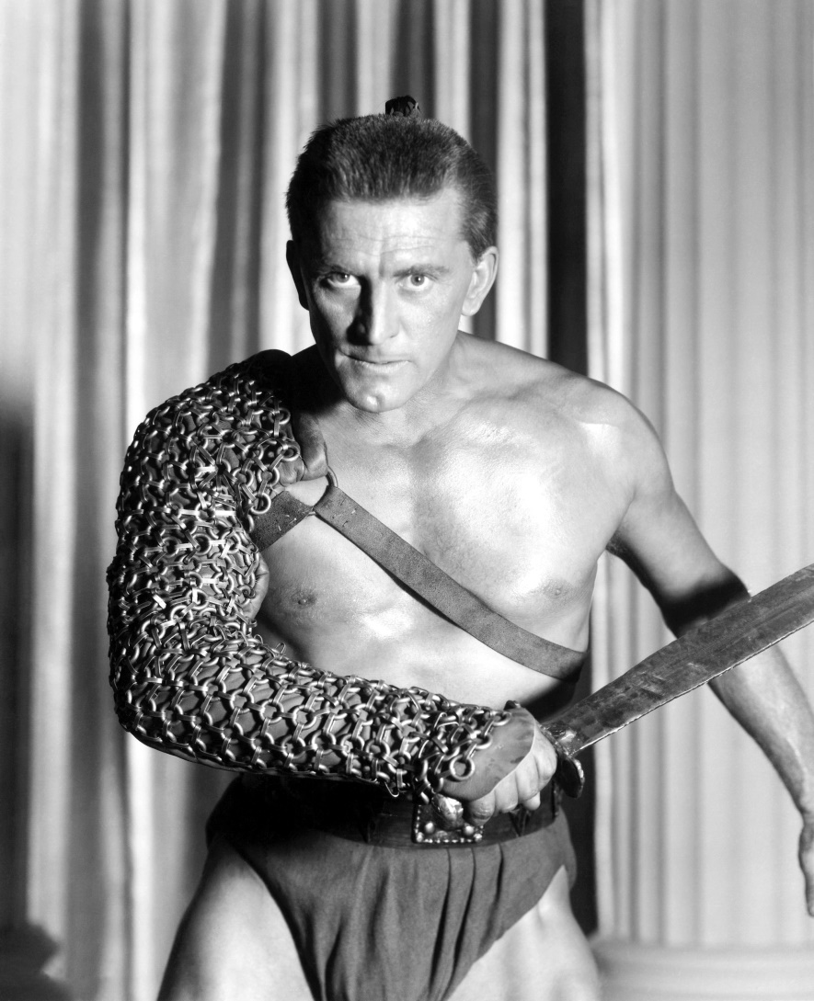
Spartacus
c. 106-71 BCE
Thracian slave
Led a revolt of gladiators and farmhands in 73
The rebels fled to Mt. Vesuvius, then tried to escape to Sicily, but were betrayed by Cilician pirates
Defeated by Crassus in 71

Slide 8
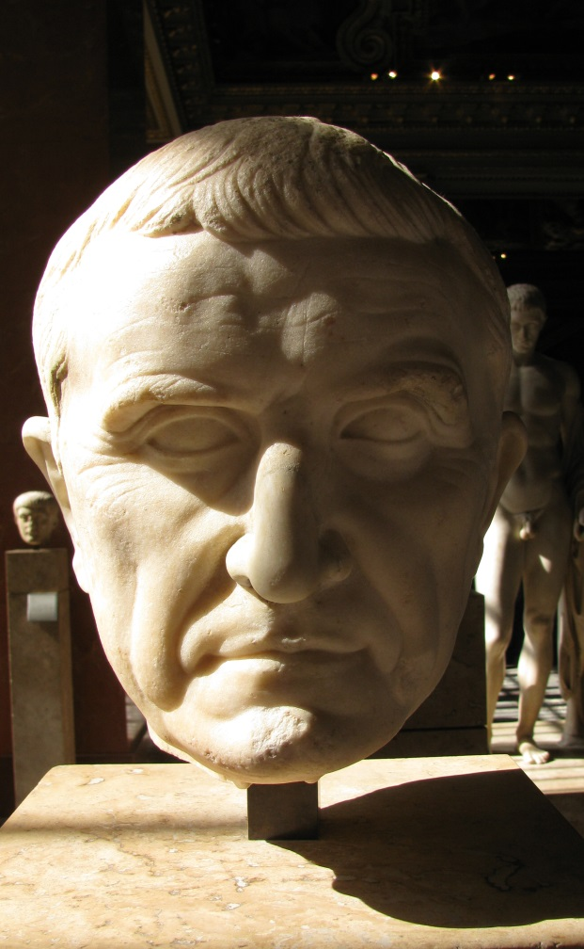
Crassus
Marcus Licinius Crassus
c. 115-53 BCE
Supported Sulla during the civil war with Marius
Got rich off Sulla’s proscriptions and by buying property that was on fire
Given the task of quashing Spartacus’ revolt
Crucified 6000 captured slaves along the Via Appia

Slide 9
Consuls in 70 bce

Slide 10
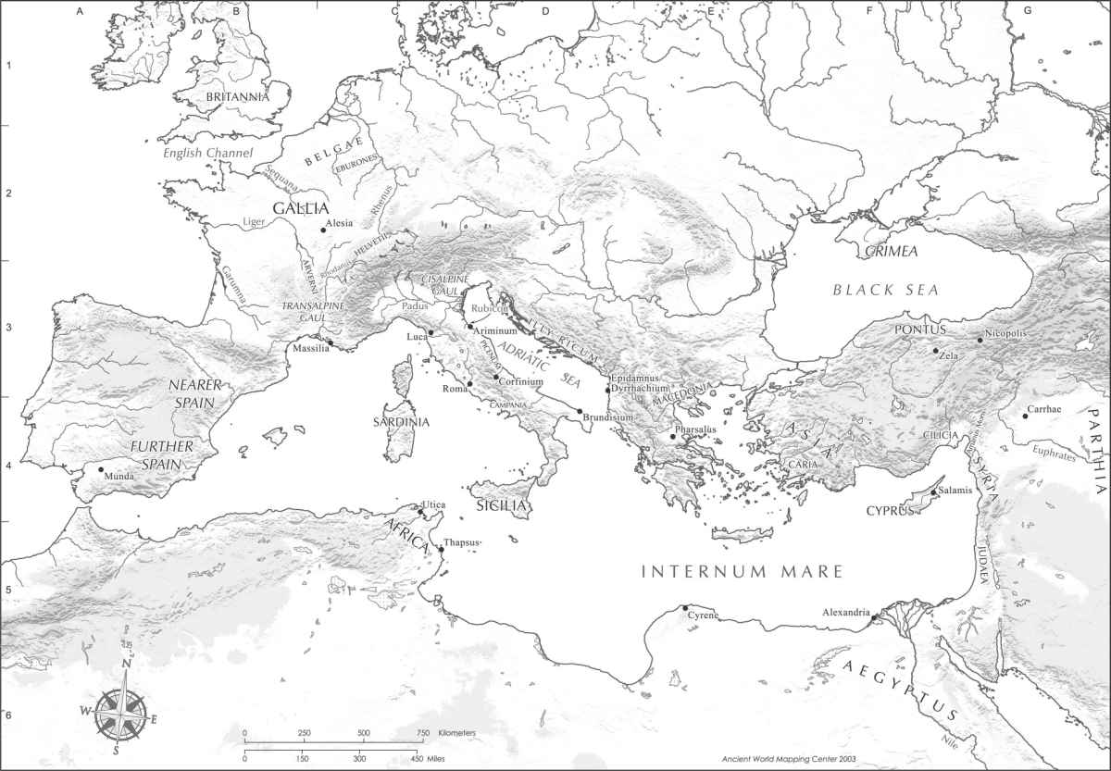
Pirates!

Slide 11
Pompey vs. the Pirates
Pompey declined a province after the end of his consulship
Tribune proposed creation of a special three-year command outranking other Roman officials
Gave him 24 legates, 500 warships, and 120,000 men
Swept the Mediterranean from west to east
Defeated a pirate fleet at Coracesium and destroyed their bases in Cilicia
Pirates who surrendered were settled in new colonies

Slide 12
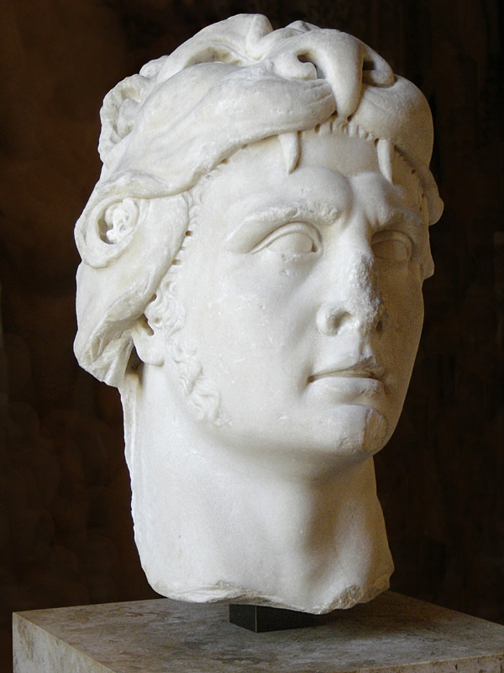
Mithradates
Mithradates VI, king of Pontus 120-63 BCE
Supposedly took poison as a child to built up his tolerance
Invaded the province of Asia in 88; surrendered to Sulla in 85
Formed an alliance with Sertorius and the Cilician pirates, and invaded the new Roman province of Bithynia c. 74 BCE

Slide 13
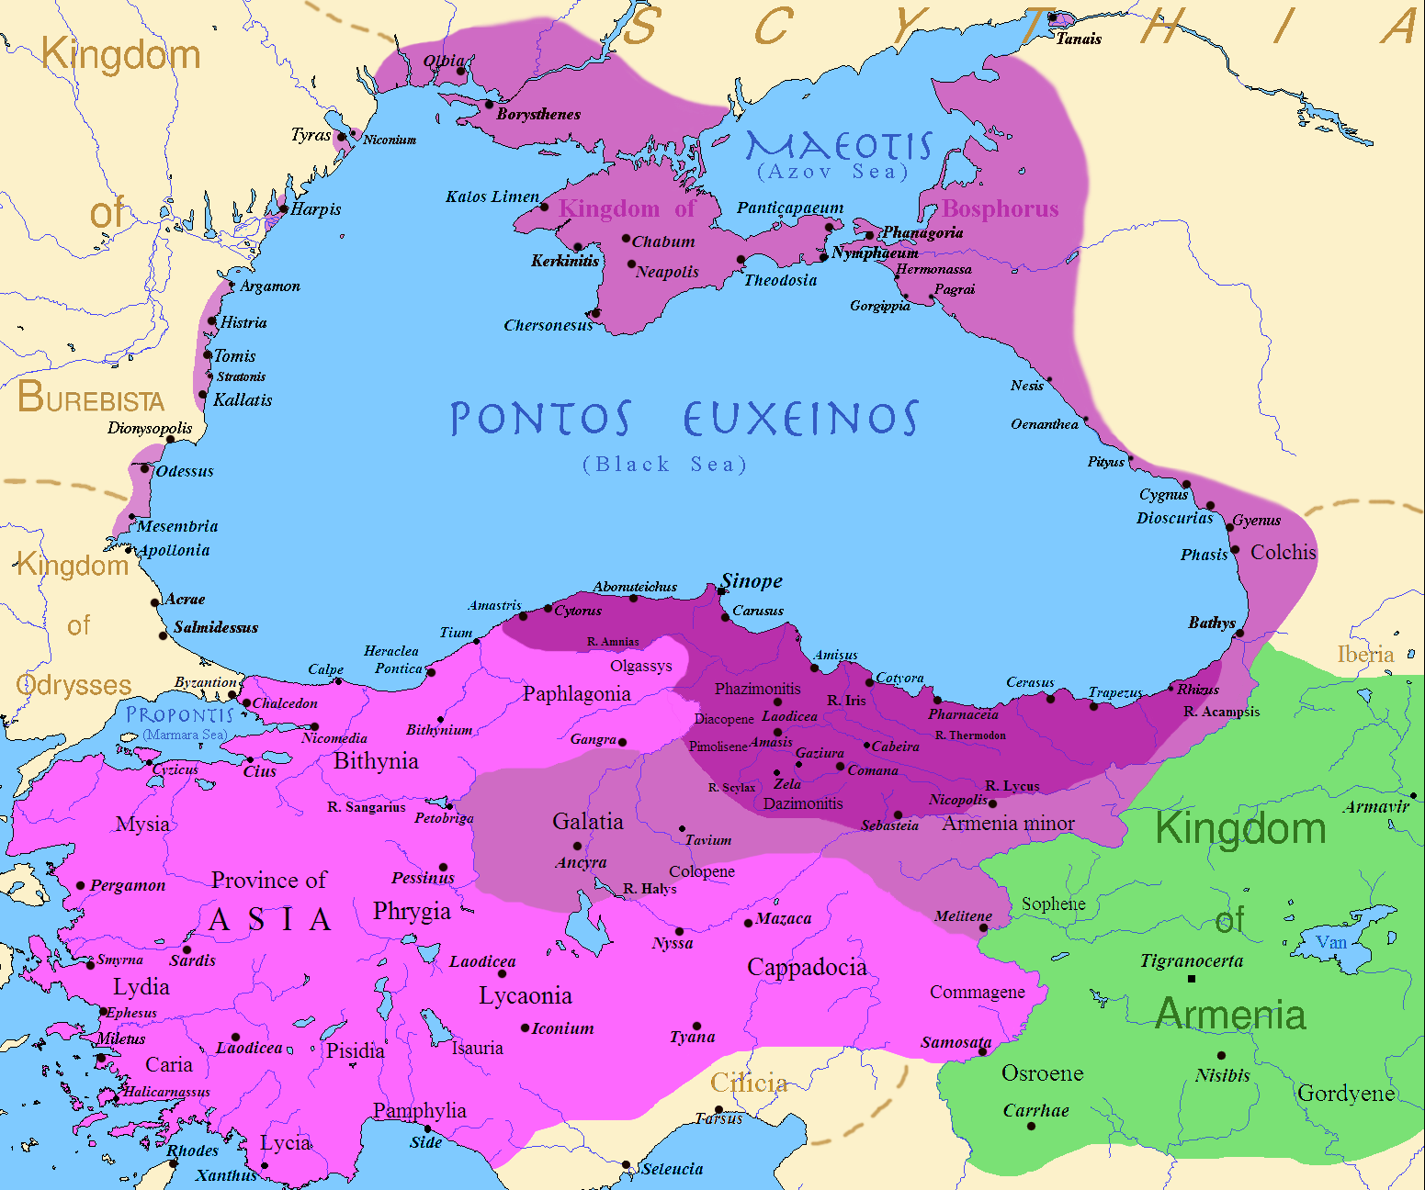
Mithradates
Pontus
Roman province of Asia
Roman province of Bithynia
Cilicia

Slide 14
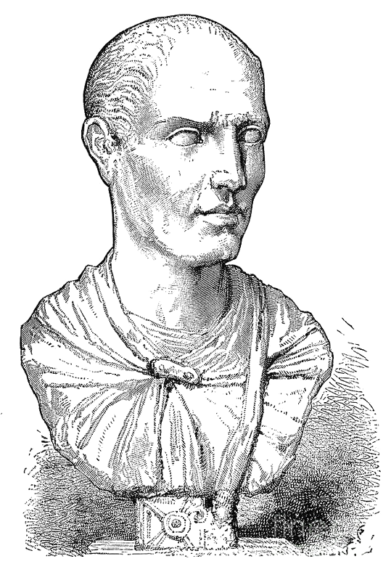
Lucullus
Lucius Licinius Lucullus
c. 118-56 BCE
Consul in 74
Proconsul of Asia with command against Mithradates
Drove Mithradates out of Asia and defeated him in Armenia, but could not destroy his army
Command given to Pompey instead, who was already there

Slide 15
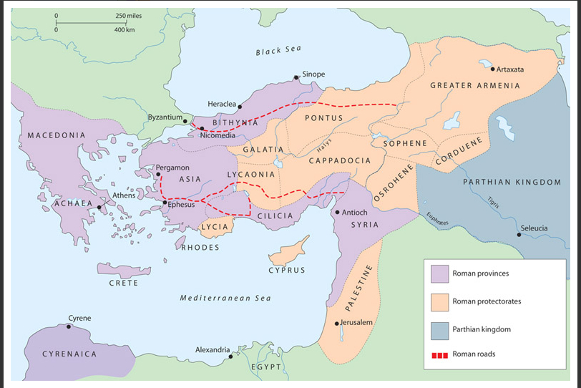
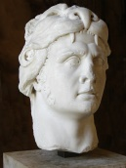
Pompey in the East

Slide 16
Inscription on the Temple of Venus
*
“Pompey the Great, son of Gnaeus, Imperator, having liberated the seacoast of the inhabited world and all islands in the Ocean from the war with the pirates – being likewise the man who delivered from siege the kingdom of Ariobarzanes, Galatia and the lands and provinces lying beyond it, Asia and Bithynia…extended the frontiers of the Empire to the limits of the earth, and secured and in some cases increased the revenues of the Roman people – he, by confiscation of the statues and the images set up to the gods, as well as other valuables taken from the enemy, has dedicated to the goddess 12,060 gold pieces and 307 talents of silver.”
- Diodorus Siculus 40.4.1

Slide 17
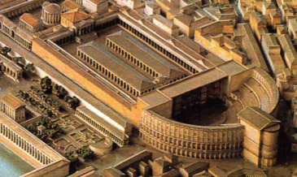
Theater of Pompey
First permanent theater in Rome
Inspired (and probably funded) by Pompey’s eastern conquests
Completed c. 55 BCE
Used for political meetings as well as performances
Had numerous sculptures of Pompey

Slide 18

Meanwhile in Rome…
Crassus attempted to curb Pompey’s power
Proposed to create a commission to sell land captured in the provinces to fund the purchase of land in Italy for veterans
So Pompey’s soldiers wouldn’t have to rely on him for land
Recruited allies: Lucius Sergius Catalina (Catiline) and Gaius Julius Caesar
Catiline ran unsuccessfully for consul in 63
Defeated by Cicero

Slide 19
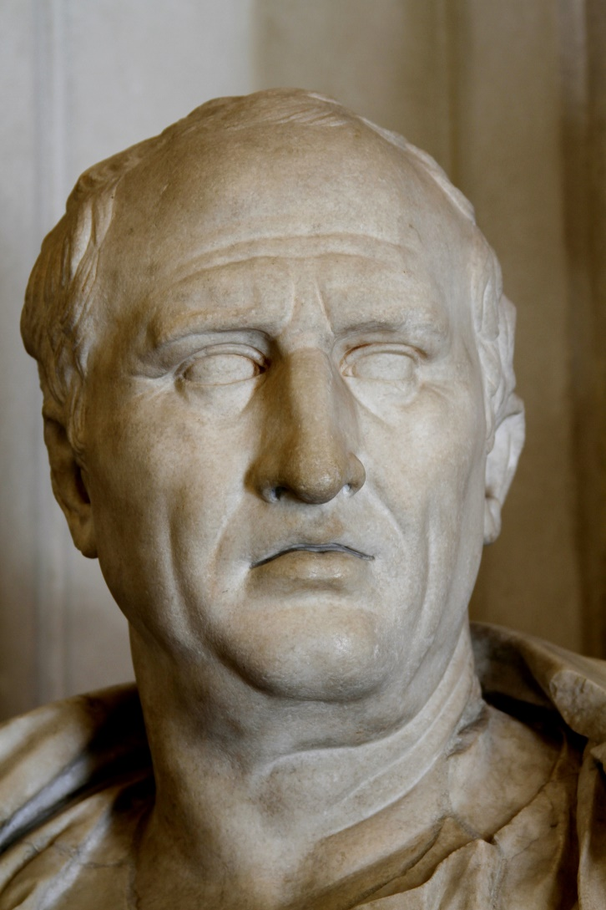
Catiline’s Conspiracy
Catiline recruited a following among the indebted, politically unsuccessful, and urban poor
Raised an army in Etruria
Defeated and killed in battle
Several of his supporters in Rome were arrested by Cicero
Asked the senate for guidance
Caesar supported imprisonment, Cato the Younger supported execution
Executed without trial shortly thereafter

Slide 20
Catiline’s Reasons
*
“I have therefore resolved to make no defense of my unusual conduct; that I offer an explanation is due to no feeling of guilt, and I am confident that you will be able to admit to its justice. Maddened by wrongs and slights, since I had been robbed of the fruits of my toil and energy and was unable to attain to a position of honor, I followed my usual custom and took up the general cause of the unfortunate; not that I could not pay my personal debts from my own estate…but because I saw the unworthy elevated to honors, and realized that I was an outcast because of baseless suspicion. It is for this reason that, in order to preserve what prestige I have left, I have adopted measures which are honorable enough considering my situation.”
- Sallust, Catiline 35

Slide 21
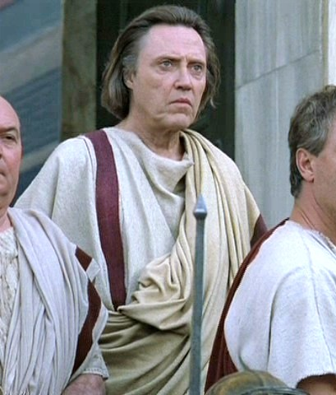
Cato the Younger
Marcus Porcius Cato Uticensis
c. 95-46 BCE
Great-grandson of Cato the Elder
Voted for the execution of the Catilinarian conspirators
Staunch optimatis and opponent of both Pompey and Caesar
Cicero accused him of living in Plato’s republic (Att. 2.1.8)

Slide 22
The Return of Pompey
Returned to Italy from the east in 62 BCE
Gave up command of his army because he expected to be awarded a triumph
He was not
Tried to get a land bill for his veterans
The senate, led by Lucullus, opposed him, and also refused to ratify his administrative changes in the east

Slide 23


The First Triumvirate
Pompey the Great
Julius Caesar
Marcus Crassus

Slide 24
Caesar as Consul
Consul in 59 BCE with Marcus Calpurnius Bibulus, a staunch optimatis
But Bibulus eventually refused to leave his house and began issuing decrees based on astrology
Passed Pompey’s land bill using violence
Granted Cisalpine Gaul as his province for three years!

Slide 25
Caesar in Gaul
c. 58-50 BCE

Slide 26
Meanwhile in Rome…
Pompey was given command over the grain supply
Opposed by Crassus
Caesar convinced Pompey and Crassus to run for consul together in 55 BCE
Each would get his own multi-year military command
Caesar would furlough his legions so they could vote
In exchange Caesar’s command in Gaul was extended

Slide 27
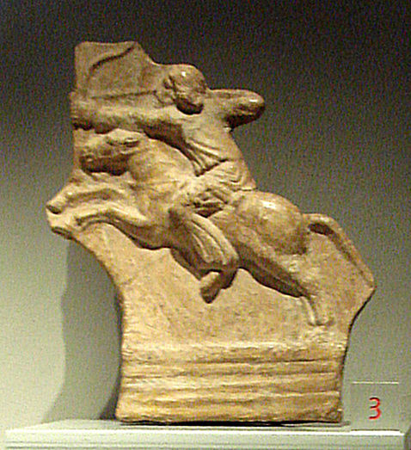
Crassus vs. the Parthians
Nomadic group who conquered the Seleucid province of Parthia c. 238 BCE
Led by Arsaces, whose descendants ruled as kings
Eventually conquered much of the former Seleucid Empire
Famed for the ‘Parthian shot’

Slide 28
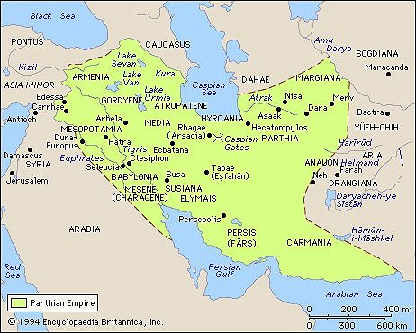

The Death of Crassus
Carrhae, 53 BCE

Slide 29
Pompey and the Senate
All candidates for consul in 54 BCE were charged with bribery
Had an ally propose to make him dictator and had Cicero appear to oppose
Appointed interrex instead, and oversaw new elections
Cato accused him of “contriving disturbances”
New consuls didn’t hold elections at the end of their term
So Pompey was appointed sole consul
Introduced a law requires candidates for consul to stand in person

Slide 30
Cicero’s Assessment
*
“The possibilities are as follows: (1) Caesar’s candidature may be admitted while he still retains his army either by favor of the senate or of the tribunes. (2) Caesar may be persuaded to hand over his province and army and so become consul. (3) If he be not so persuaded, elections may be held without admission of his candidature, he not obstructing, and meanwhile retaining his province. (4) Should he obstruct this by means of tribunes but not resort to violence, there will be an interregnum. (5) If he brings up his army because his candidature is not accepted we must fight him.”
- Cicero, Letters to Atticus 7.9.2 (50 BCE)

Slide 31
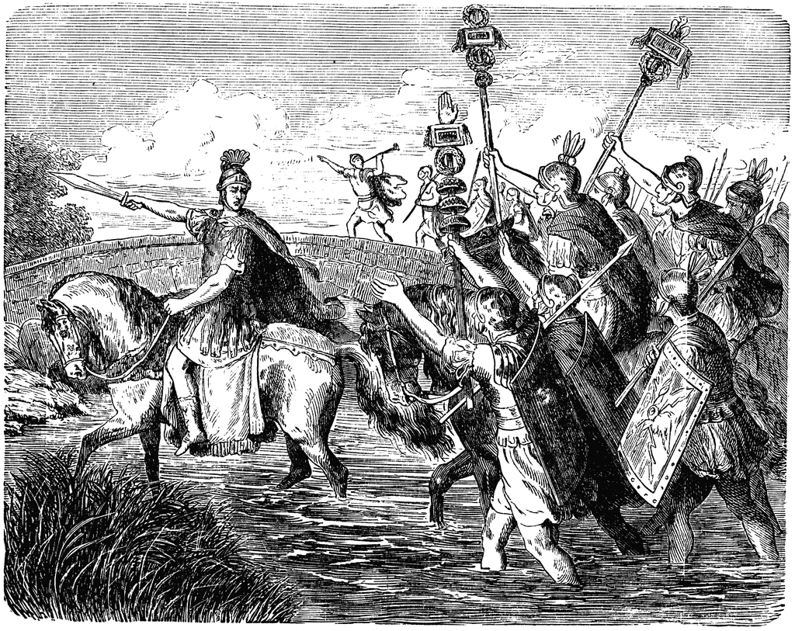
“The die is cast”

Slide 32
Civil Wars
Marius
Sulla
Crassus
Pompey
Julius Caesar
Mark Antony
Octavian

Slide 33
Key Terms
Gnaeus Pompey
Marcus Licinius Crassus
Julius Caesar
Sertorius
Mithradates
Cilicia
Cato the Younger
Spartacus
Rubicon
triumph

